Slide 1
An Investigation of Slope-Intercept Form
By: Larissa Gluszak

Slide 2
Goals/Objectives
Goal: The students will investigate slope-intercept form using hands-on materials
Objectives: Students will explain slope as a rate of change between dependent and independent variables. Students will determine the slope of a line, given the coordinates of two points on the line.

Slide 3
Materials
Plastic Bag
Rubber Band
Washers
Pencil
Tape
Ruler (centimeter)
Calculator
Worksheet

Slide 4
Procedure
Step 1: Cut a hole in a top corner of a plastic sandwich bag. Loop a long rubber band through the hole.

Slide 5
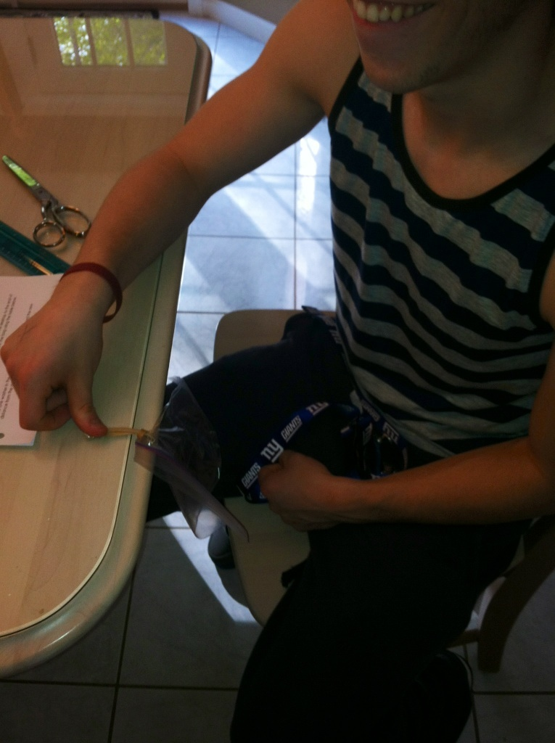
Procedure
Step 2: Tape the free end of the rubber band to the desktop.

Slide 6
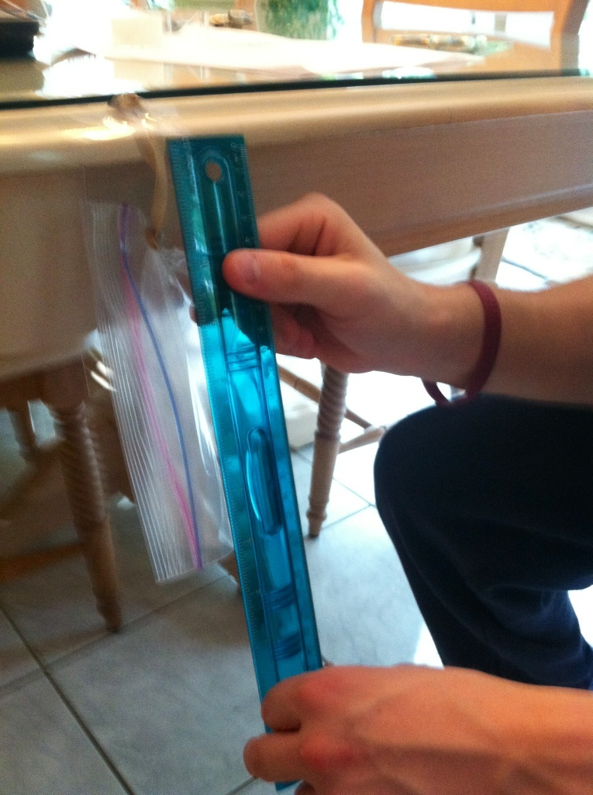
Procedure
Step 3: Use a centimeter ruler to measure the distance from the desktop to the end of the bag. Record this distance for 0 washers in the bag using the table.

Slide 7
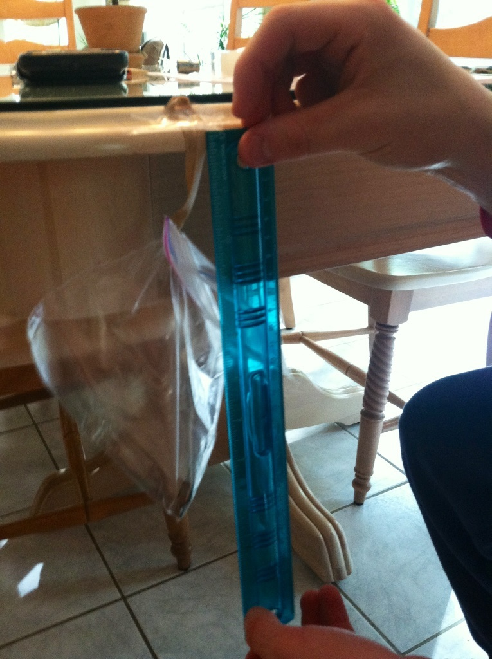
Procedure
Step 4: Place one washer in the plastic bag. Then measure and record the new distance from the desktop to the end of the bag.

Slide 8
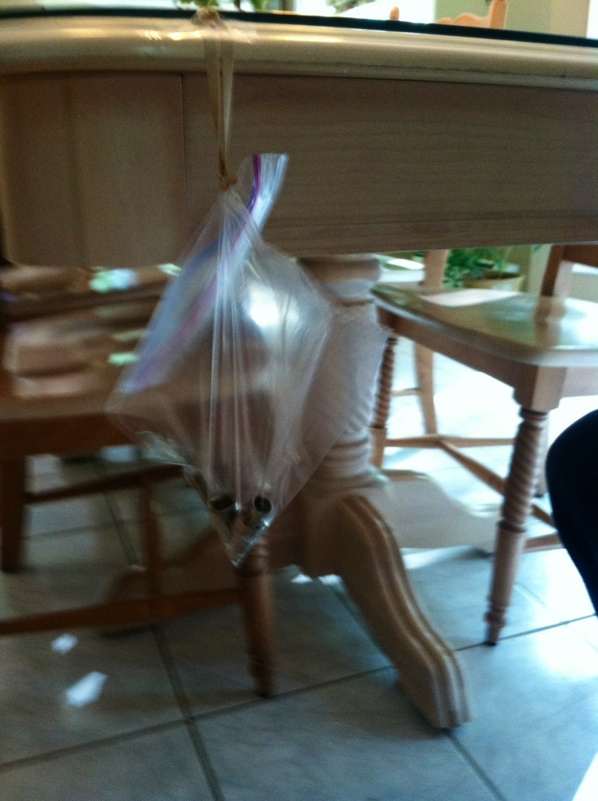
Procedure
Step 5: Repeat the experiment, adding different numbers of washers to the bag. Each time, record the number of washers and the distance (in centimeters) from the desktop to the end of the bag.

Slide 9
Procedure
Number of Washers | Distance (Centimeters)
X | Y
0 | 7
1 | 7.2
2 | 7.5
3 | 7.8
4 | 8
5 | 8.2
6 | 8.5
7 | 8.6
8 | 8.8

Slide 10
It’s time to analyze the data!
We know that the domain contains values represented by the independent variable, washers (x-axis).
We also know that the range contains values represented by the dependent variable, distance (y-axis).

Slide 11
It’s time to analyze the data!
Washers and a Desktop!
Distance (Centimeters)
Number of Washers

Slide 12
It’s time to analyze the data!
Have the students write a sentence to describe the points on the graph
Then, have the students describe the point that represents the trial with no washers in the bag.
Go over the formula for slope:
Rise = change in distance run change in # of washers * Have the students find the rate of change in the distance from the desktop to the end of the bag as more washers are added.
How is the rate of change shown on the graph?

Slide 13
Additional Questions
Draw a graph for each of the following situations:
1. A bag that hangs 10.5 centimeters from the desktop when empty and lengthens at the rate of the sample
2. A bag that has the same length when empty as the sample and lengthens at a faster rate.
3. A bag that has the same length when empty as the sample and lengthens at a slower rate.

